Slide 1
INTRO TO CSS

Slide 2
INTRO TO CSS
Covered in this lesson:
  Overview
    What is CSS?
    Why to use CSS?
    CSS for Skinning your Website
  Structure
    CSS Syntax Introduction
    Three places CSS can be defined
    CSS Syntax Specifics
    Cascading Inheritance
  Applied
    CSS Hands-on

Slide 3
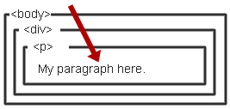
WHAT IS CSS?
Cascading Style Sheet
    Stylesheet Language
      Standards-based set of properties and attributes to define styles
    To describe the presentation a document written in a
    ‘markup language’ like HTML or XML
      Markup encoding: <p>My paragraph here.</p>
      Defines the style of how things in <p> tags appear.
      Font, color, size, margins, etc.
    Cascading
      Rules to determine how to
      apply markup that contains
      other markup

Slide 4
WHY CSS?
Separate Content from Form
  Content is the text and images, marked up to define regions of specific types
  Form defines the “style” for the content
<font size=“14px”>
My First Header
</font>
<font size=“12px” color=“red” face=“Verdana”>
My information 1 goes here.
</font>
<font size=“14px”>
My Second Header
</font>
<font size=“12px” color=“red” face=“Verdana”>
Different information goes here.
</font>
The old way:

Slide 5
WHY CSS? CONTINUED.
Separate Content from Form
  Content
  Form or Style
<p class=“header”>My First Header</p>
<p class=“info”>My Information 1 goes here</p>
<p class=“header”>My Second Header</p>
<p class=“info”>Different Information goes here</p>
(Specific markup properties like Class will be discussed later).
.header { font-size:14px;}
.info { font-family: verdana;
font-color: blue;
font-size: 12px; }

Slide 6
WHAT DOES THIS SEPARATION GET US?
Separate Content from Form
  Specify the style once for every instance of that class.
    Example: Specify the font once for all text on the HTML page that you’ve identified as a “header”.
  The stylesheet can be a separate file which all HTML pages on your entire site can link to.
    Only have to specify the style once for your ENITRE SITE
  Can change the style for your entire site by editing only ONE FILE.

Slide 7
CSS SKINNING
“Skinning” - changing the look of a page or your site
  Selecting an appearance by choosing which stylesheet to use.
<link rel="stylesheet" type="text/css" href=“skin1.css" />
<p class=“info”>My Information 1 goes here</p>
+
skin1.css
.info { background-color: White;
font-family: Verdana;
font-color: Blue; }
=
Some information goes here.

Slide 8
CSS SKINNING 2
“Skinning” - changing the look of a page or your site
  Selecting an appearance by choosing which stylesheet to use.
<link rel="stylesheet" type="text/css" href=“skin2.css" />
<p class=“info”>My Information 1 goes here</p>
+
skin1.css
.info { background-color: Blue;
font-family: Serif;
font-color: White; }
=
Some information goes here.

Slide 9
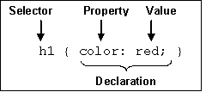
CSS SYNTAX
3 Elements to a CSS Statement
  Selector
    What HTML sections does it affect?
  Property
    What attribute of that HTML section will be affected?
  Value
    What change will be made to that attribute?

Slide 10
THREE CSS DEFINITION LOCATIONS
Inline: the “style” attribute
  Note, the selector for inline CSS is the tag which contains the style attribute.
Internal: the <style> markup tag
External: the .css stylesheet file
<p style=“font-color:red;font-size:10px;”>Content</p>
<html><head><style>
p { background-color: Red;
font-family: serif;
font-color: White; }
</style></head><body>
<p>Content</p>
</body></html>
<link rel="stylesheet" type="text/css" href=“mystylesheet.css" />

Slide 11
CSS SYNTAX: SELECTORS
There are many kinds of selectors and many ways to reference them:
  Type, Class, ID, Pseudo, etc.
HTML Type Tag – selected with the tag type
The Class Attribute – precede the class with a period
p { font-size: 10px;
font-color: White; }
<p>Content</p>
.myinfo { font-size: 10px;
font-color: White; }
<p class=“myinfo”>Content</p>
<div class=“myinfo”>Other content</div>

Slide 12
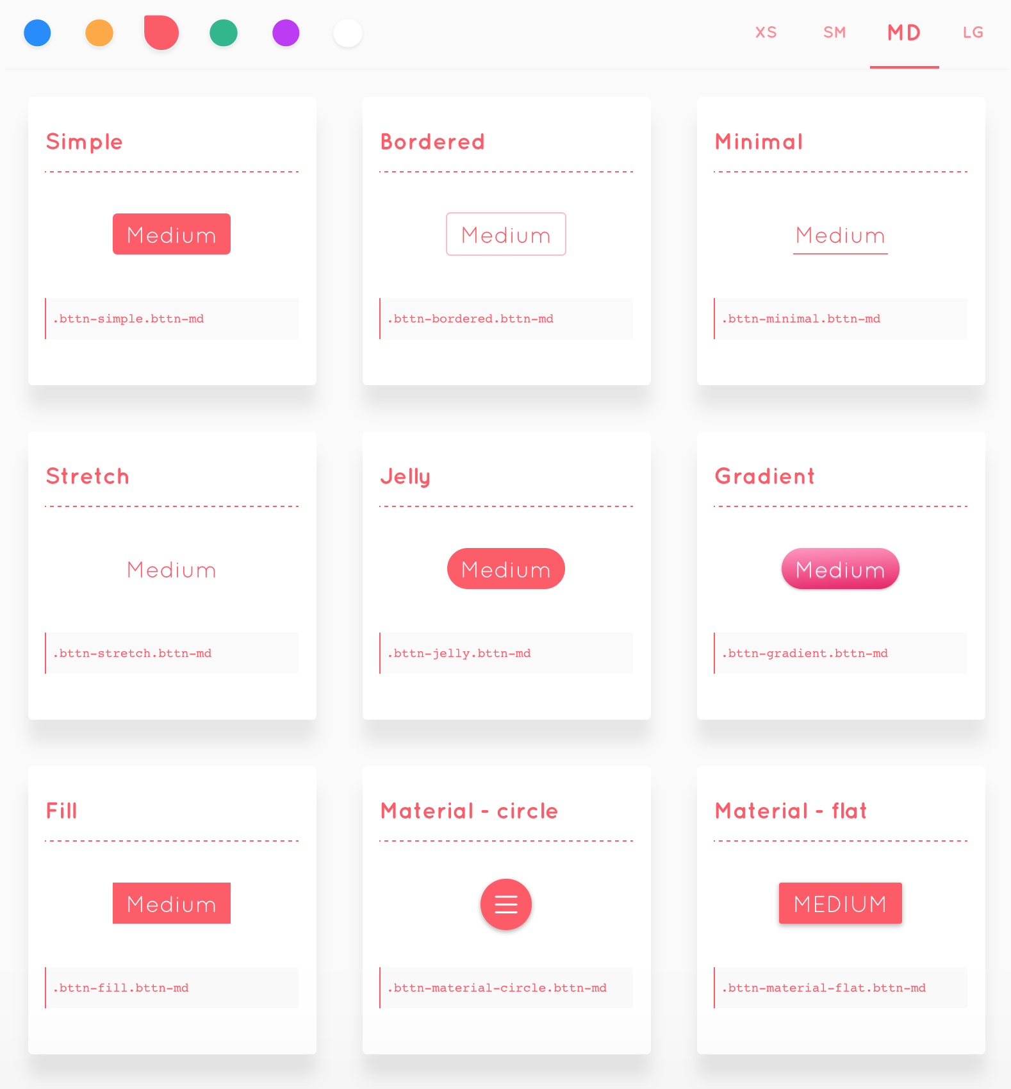
CSS
CSS allows us to specify how to present (render) the document info stored in the HTML.
Thanks to CSS we can control all the aspects of the visualization and some other features:
Colors: content, background, borders
Margins: interior margin, exterior margin
Position: where to put it
Sizes: width, height
Behaviour: changes on mouse over

Slide 13
CSS EXAMPLE
* {
color: blue; /*a comment */
margin: 10px;
font: 14px Tahoma;
}
This will change all the tags in my web ( ‘*‘ means all) to look blue with font Tahoma with 14px, and leaving a margin of 10px around.

Slide 14
CSS FIELDS
Here is a list of the most common CSS fields and an example:
color: #FF0000; red; rgba(255,00,100,1.0); //different ways to specify colors
background-color: red;
background-image: url('file.png');
font: 18px 'Tahoma';
border: 2px solid black;
border-top: 2px solid red;
border-radius: 2px; //to remove corners and make them more round
margin: 10px; //distance from the border to the outer elements
padding: 2px; //distance from the border to the inner elements
width: 100%; 300px; 1.3em; //many different ways to specify distances
height: 200px;
text-align: center;
box-shadow: 3px 3px 5px black;
cursor: pointer;
display: inline-block;
overflow: hidden;

Slide 15
CSS HOW TO ADD IT
There are four ways to add CSS rules to your website:
Inserting the code inside a style tag
<style>
p { color: blue }
</style>
Referencing an external CSS file
<link href="style.css" rel="stylesheet" />
Using the attribute style on a tag
<p style="color: blue; margin: 10px">
Using Javascript (we will see this one later).

Slide 16
CSS SELECTORS
Let's start by changing the background color of one tag of our website:
div {
background-color: red;
}
This CSS rule means that every tag DIV found in our website should have a red background color. Remember that DIVs are used mostly to represent areas of our website.
We could also change the whole website background by affecting the tag body:
body {
background-color: red;
}

Slide 17
CSS SELECTORS
What if we want to change one specific tag (not all the tags of the same type).
We can specify more precise selectors besides the name of the tag. For instance, by class or id. To specify a tag with a given class name, we use the dot:
p.intro {
color: red;
}
This will affect only the tags p with class name intro:
<p class="intro">

Slide 18
CSS SELECTORS
There are several selectors we can use to narrow our rules t
tag name: just the name of the tag
  p { ... } //affects to all <p> tags
dot (.): affects to tags with that class
  p.highlight { ... } //affects all <p> tags with class="highlight"
sharp character (#): specifies tags with that id
  p#intro { ... } //affects to the <p> tag with the id="intro"
two dots (:): behaviour states (mouse on top)
  p:hover { ... } //affects to <p> tags with the mouse over
brackets ([attr='value']): tags with the attribute attr with the value 'value'
  input[type="text"] {...} // affects to the input tags of the type text

Slide 19
CSS SELECTORS
You can also specify tags by its context, for example: tags that are inside of tags matching a selector. Just separate the selectors by an space:
div#main p.intro { ... }
This will affect to the p tags of class intro that are inside the tag div of id main
<div id="main">
<p class="intro">....</p> ← Affects this one
</div>
<p class="intro">....</p> ← but not this one

Slide 20
CSS SELECTORS
And you can combine selectors to narrow it down more.
div#main.intro:hover { ... }
will apply the CSS to the any tag div with id main and class intro if the mouse is over.
And you do not need to specify a tag, you can use the class or id selectors without tag, this means it will affect to any node of id main
#main { ... }

Slide 21
CSS SELECTORS
If you want to select only elements that are direct child of one element (not that have an ancestor with that rule), use the > character:
ul.menu > li { ... }
Finally, if you want to use the same CSS actions to several selectors, you can use the comma , character:
div, p { … } ← this will apply to all divs and p tags

Slide 22
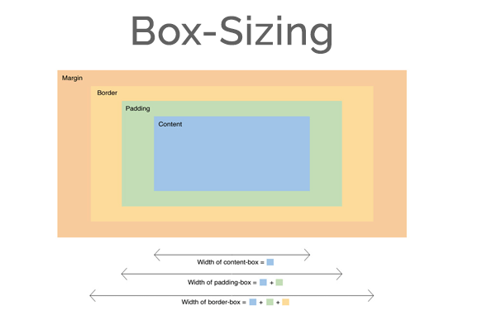
BOX MODEL
It is important to note that by default any width and height specified to an element will not take into account its margin, so a div with width 100px and margin 10px will measure 120px on the screen, not 100px.
This could be a problem breaking your layout.
You can change this behaviour changing the box model of the element so the width uses the outmost border:
div { box-sizing: border; }

Slide 23
CASCADING INHERITANCE
Nested elements inherit
the properties from the
its parent
If you specify a style for the
<body> tag it will affect all
content in your HTML page.
If you want to override
inherited settings, you
need to specify a style in
a more local element
body { font-family: Verdana;
font-size: 14px; }
body { font-family: Verdana;
font-size: 1.1em; }
.littletext { font-size: 8px; }
<body>
This text is larger.
<p class=“littletext”>This text is smaller.</p>

Slide 24
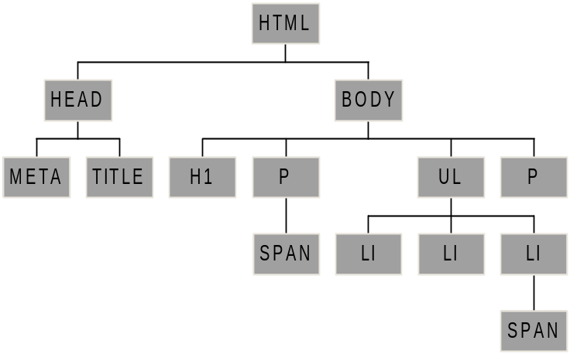
HTML PARSE TREE
<html>
  <head>
    <meta … />
    <title>…</title>
  </head>
  <body>
    <h1>…</h1>
    <p>…<span>…</span>…</p>
    <ul>
      <li>…</li>
      <li>…</li>
      <li>…<span>…</span>…</li>
    </ul>
    <p>…</p>
  </body>
</html>
What will h1 + p match?
What will ul > span match?
What will ul {color:blue} do?
Notes:
Dalhousie CSCI 3172
Lecture: CSS Essentials
Fall 2007–2008 version

Slide 25
CSS APPLIED
Hands-on CSS Tutorial

